Slide 1
Integrated Assessment Models
I’m the king of the world! — Jack Dawson. Ivo Welch

Slide 2
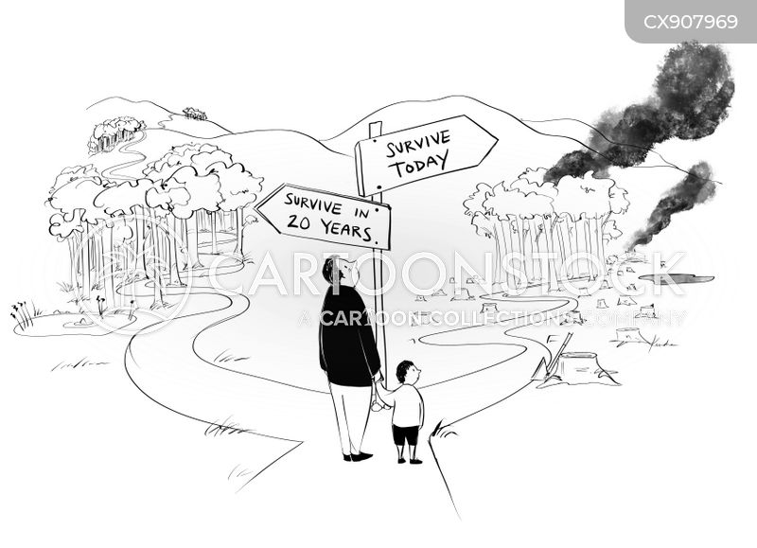
survive-today-tomorrow

Slide 3
IAMS
Basis of all international negotiations.
Key Question: Good Tax on tCO₂.
Higher tax → lower emissions.
What is the optimal path over time?
too fast → economy RIP;
too slow → too much warming.
Nobel Prize (appropriately so) for Nordhaus (DICE). However, I will later explain why these models are practically not very useful.

Slide 4
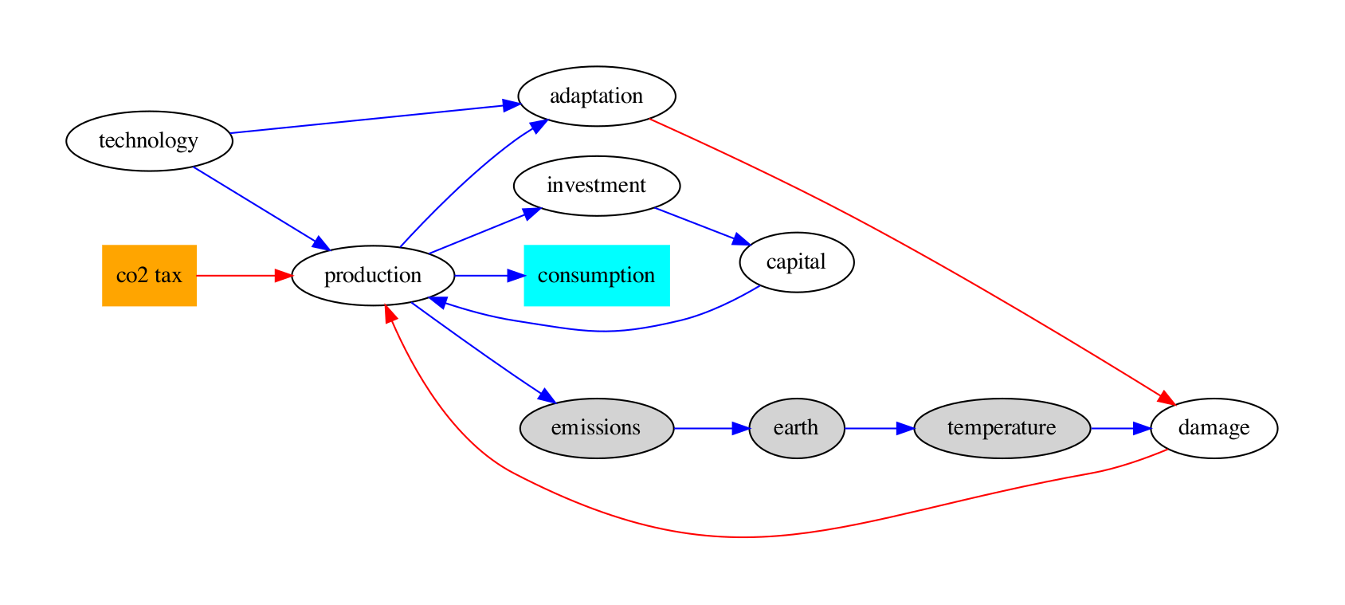
Simplified Dice Sketch

Slide 5
Basics
DICE is simpler than many other models.
DICE is one big world model.
there are also regional versions.
One benevolent policy maker optimizes tax, for all of us, both now and in the future.
over about 200 years; by then,
most fossil fuels will be exhausted.

Slide 6
Key Inputs And Outputs
Policy Inputs:
Tax rates on CO₂ for each of 200 years;
no other taxes (e.g., on children).
Model Outputs:
Sum consumption (incl. environmental!?);
Incidental: Temp, CO₂, etc.
Modeler’s Goal:
Set policy inputs to max model outputs.

Slide 7
Trustworthy?
Of course not!
But better than all alternatives,
which are also models — just terrible thoughtless ones.

Slide 8
Iam Problems
Unreliable (and difficult):
more speculative even than macro models;
way longer out in time (100-200 years);
with improving sciences and uncertainties;
even Nordhaus himself has only mild intuition.
Models need some subjective inputs, too.
Don’t take the models too seriously!
They are order-of-magnitude sketch models.

Slide 9
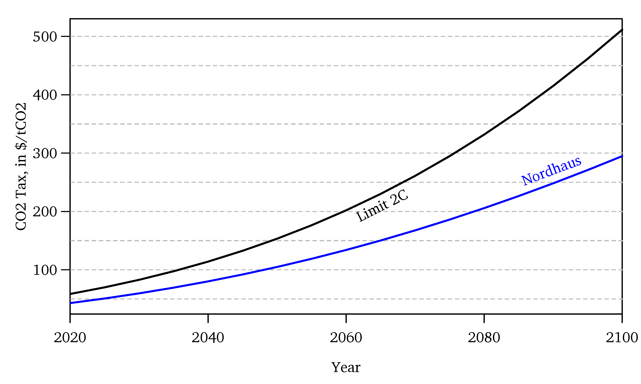
Optimal Co₂ Tax

Slide 10
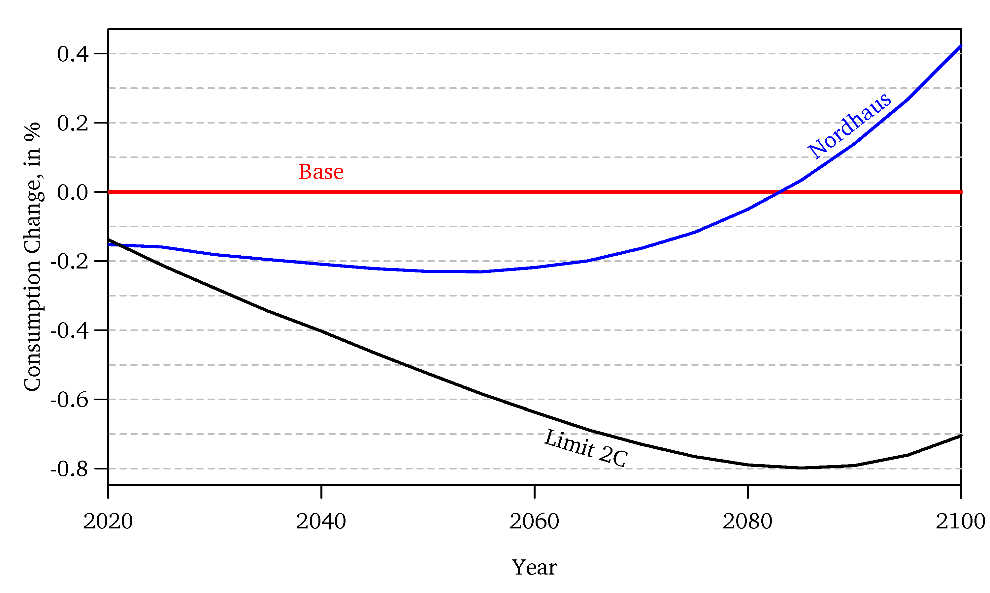
Consumption Outcome

Slide 11
Look Careful
This graph is largely based on the expected scenario.
How much will CO2 raise unknown risks?
Optimal means optimal,
even if the change is modest.
But understand the relative effects!
Even the best curbing will gain only a little consumption / benefit:
Limit to 2°C may be too aggressive — $$.
Limit to 1.5°C would be crazy — $$$$.

Slide 12
Yes, it’s optimal to curb CO₂ via a tax:
Bad for us/kids, good for the grandkids.
The world will not end w/o intervention.
Good intervention should not attempt to stop global warming:
Curbing 2°C $≠$ curbing 0.5°C .
Optimal choices are about 0.5°C more or less.
Going for stopping warming would be crazy.
Fact: The world will warm greatly!
No matter what we can reasonably do.
Prescriptive: Don’t bother with > 0.5°C.

Slide 13
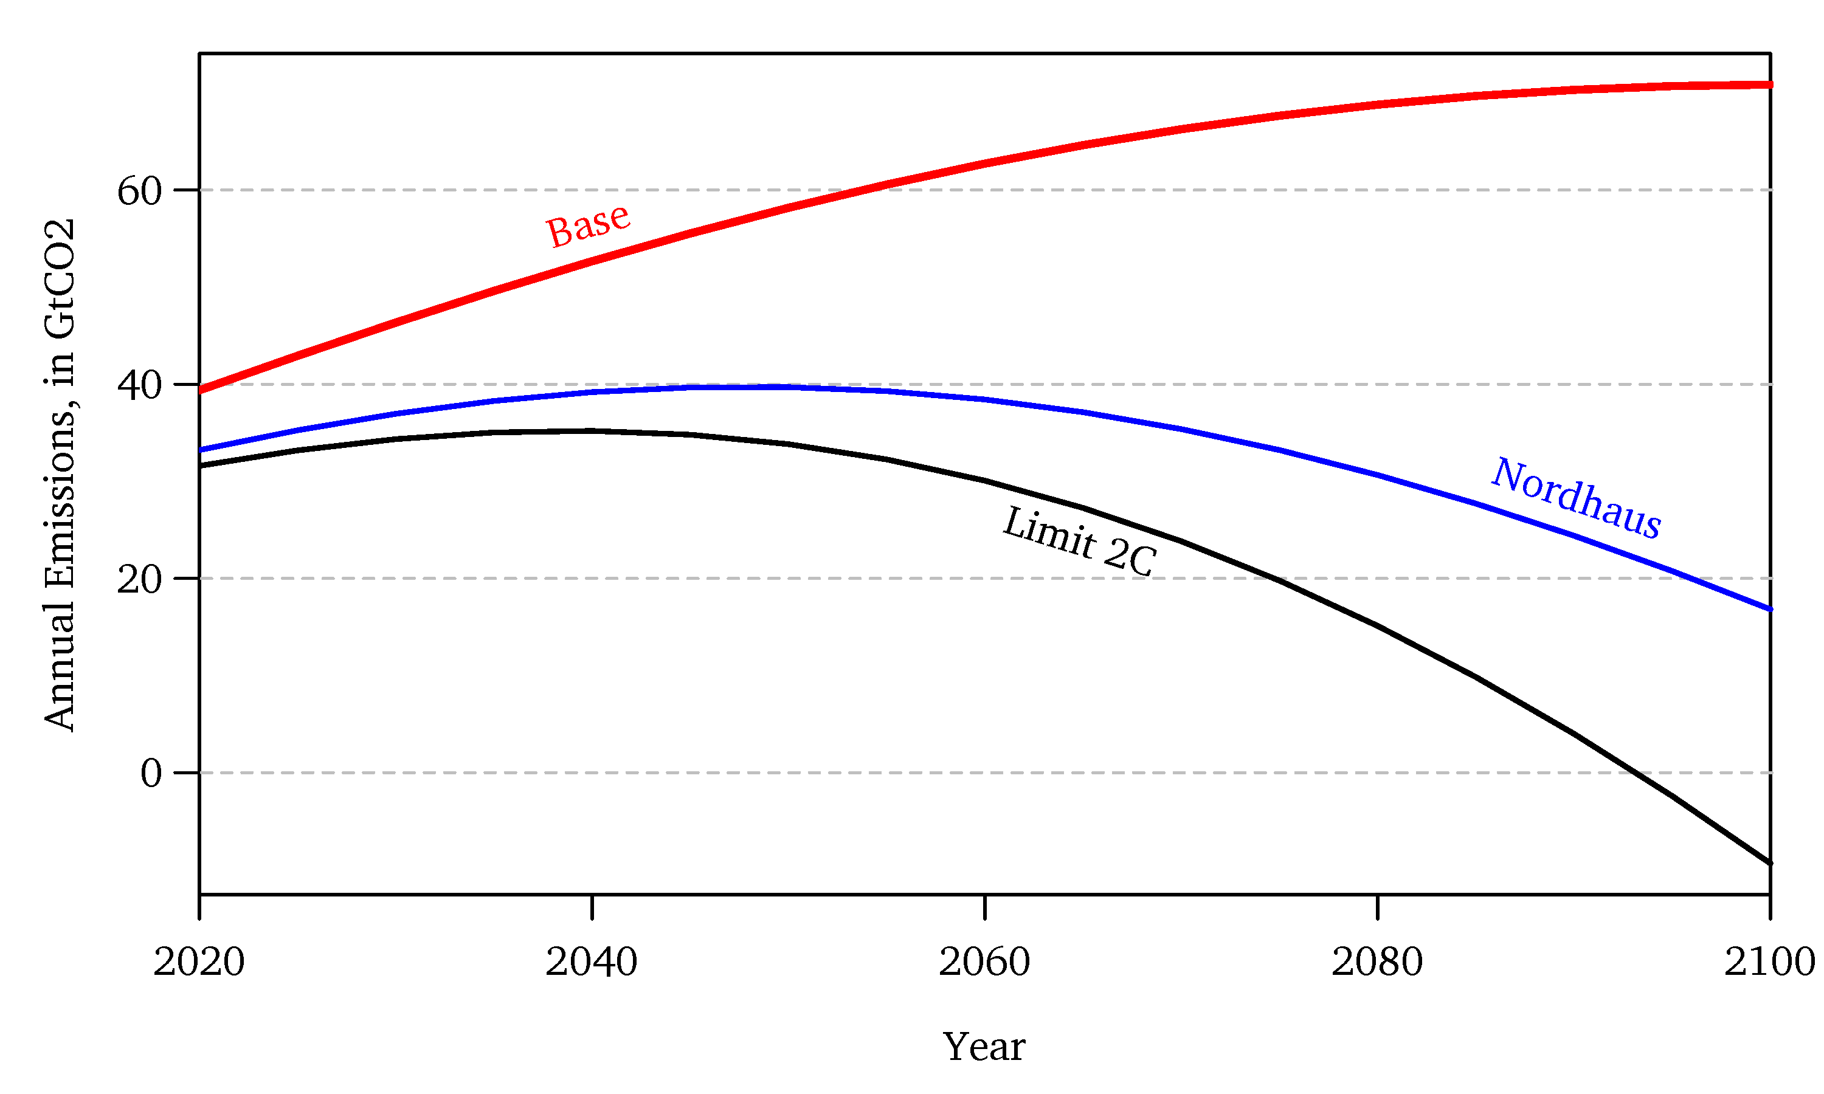
Incidental: Co₂ Emissions

Slide 14
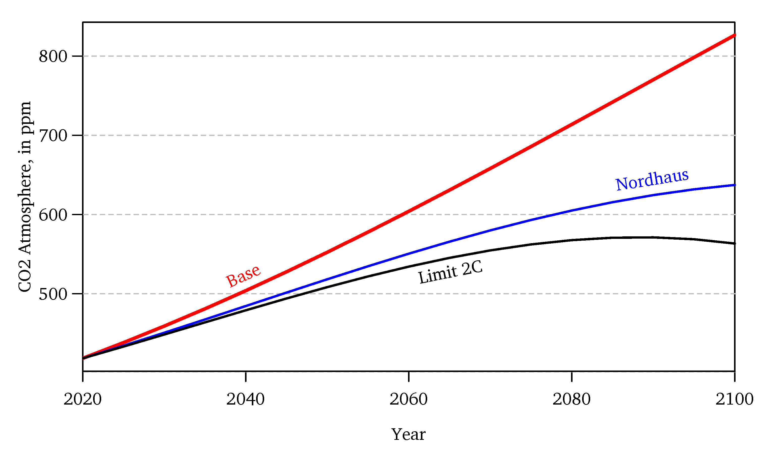
Incidental: Co₂ In Atmosphere

Slide 15
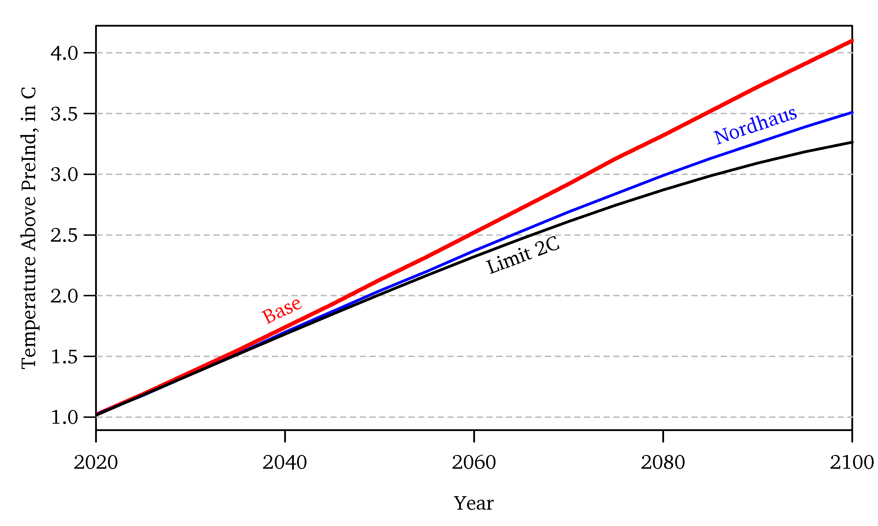
Incidental: Global Temperature

Slide 16
Adaptation Helps
Deaths and misery will very probably not be as bad as you think.
Except in very unlikely but not entirely impossible scenarios.
Life did not evolve on a risk-free planet.
Innovation will solve many problems.
See next graph:
Blue = Climate
Black = Earthquakes etc.

Slide 17
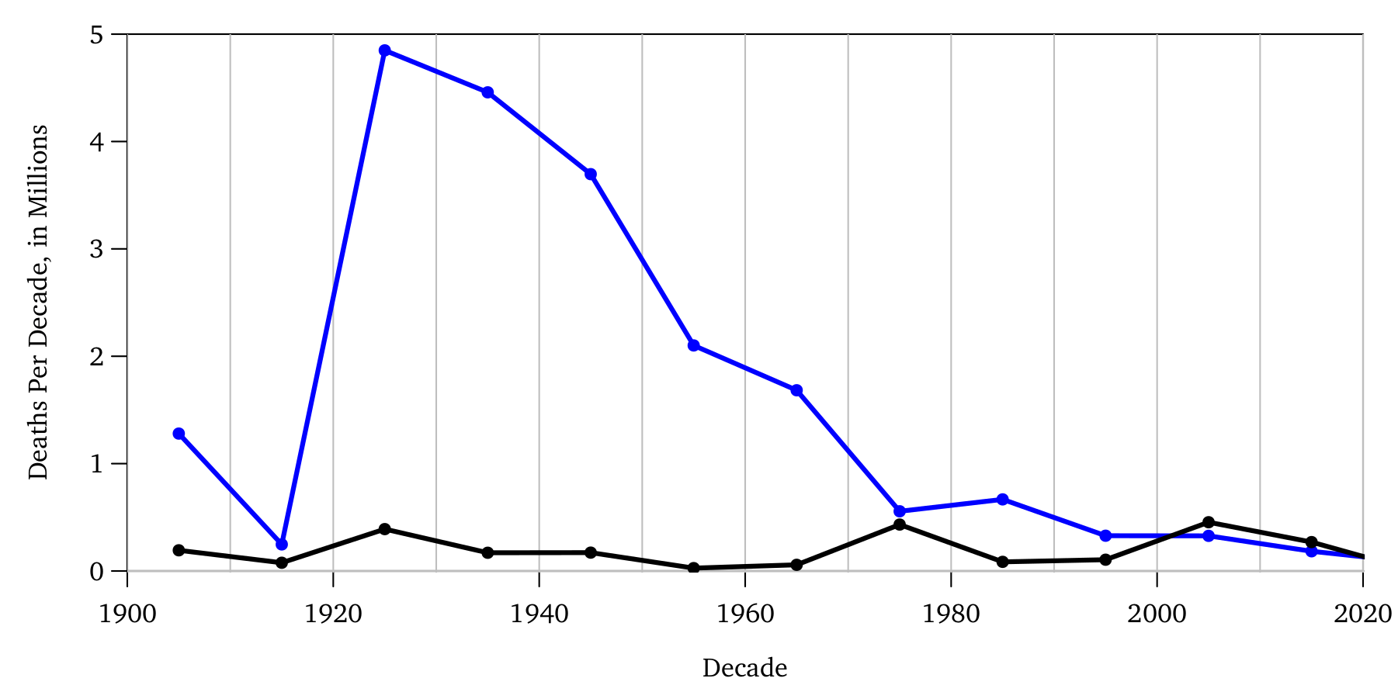
Lomborg Example: Disaster Deaths

Slide 18
Optimal Co₂ Tax Next Year
Trump: $5 /tCO₂ .
Biden: $50 /tCO₂ .
IAWG (US): $50 /tCO₂ .
Nordhaus: $50 /tCO₂ .
Stern: $80 /tCO₂ .
Range: –$15 to $2,500 /tCO₂ .
All increasing over time. All effectively phase out CO₂ completely in $≈$ 50 years.

Slide 19
Meaning Of Co₂ Tax
$50/tCO₂ means about:
50% increase in gasoline price (like Europe);
soon less important anyway.
2-5 times increase in coal;
RIP economically in most places.
2 times increase in gas;
deceptive, wrong— pipeline leakage!
Trees: subsidize by $5-10 each!

Slide 20
Most Important Disagreement
Nordhaus $50/tCO₂ .
Stern $80/tCO₂ .
Why?
Different assessments of science?
Different assessments of inputs?
Different assessment of objective?

Slide 21
Discount Rate
Biggest Disagreement:
Quasi-Philosophical:
How do we value future generations’ welfare?
What is $1 today worth in the future?
How much should we eat less today to give more to our great-great-grand-kids in the future?

Slide 22
Sensitivity Wrt D.R.
5% → $≈$ $30/tCO₂ optimal tax now.
1% → $≈$ $500/tCO₂ optimal tax now.
Stern’s d.r. was lower than Nordhaus’ d.r.:
More acrimonious in the past,
but converged over time.
Useful to have both views.
Good scientific disagreement.

Slide 23
Who Is Right On D.R.?
Economists’ efficiency consensus:
3-5% is more reasonable than 1-2%.
Nordhaus higher d.r. was more reasonable on economic grounds,
but Stern’s higher tax estimate wins back points when CC uncertainty is added.

Slide 24
What Is More Ethical?
But what is ethical?
Are we not stewards of Earth for the future?
Do ethicists pick Stern’s higher estimate?

Slide 25
What Is More Ethical?
Do we owe the future a better economy or a healthier ecology?
Would you prefer having been born
into the middle ages with a “healthy planet,”
or into today’s “unhealthy planet,” based on industrial growth and pollution?

Slide 26
What Is More Ethical?
Steward for whom?
Not for kids. Think great-great-grand-kids.
Six generations into the future, people will be $≈$ 30 times wealthier than us.
How many $$$ should today’s humanity forego so that future humanity is full 30 (not only 20) times wealthier than us?

Slide 27
Stewarding Decision?
Don’t overthink it.
Humanity is not that logical and deliberate to contemplate such questions.
How much to great-great-grand-children?
Interesting but largely irrelevant.
Our generation today makes decisions.
Future generations don’t vote!
… whether you like it or not
💊

Slide 28
Climate Suffering Of The Poor
Won’t the poor suffer the brunt of CC?
Yes, they will.
Draughts, flooding, hurricanes, etc.
We rich should/could help them by making them richer and adapt,
but probably won’t…it is what it is: 💊.
We wish poor people mattered more,
but they don’t, whether you like it or not 💊.
Is it the ethical choice to fight CC?

Slide 29
Where To Send $$$s To?
If you care for ‘others’:
Why send to future generations?
Instead why not send to the poor today?
Are not both ‘other people’ on whose behalf we rich people today should be stewards?

Slide 30
Help Today’s Poor People?!
They don’t get to vote much, either.
If humanity were more humane, what should it spend $$$s on?
0.1°C less warming in 60 years?
Or poverty and misery today:
e.g., wipe out Malaria instead?
e.g., feed all poor children instead?
Read Lomborg’s Copenhagen consensus. You need not agree, but you need to contemplate the tradeoffs.

Slide 31
Cynical View
Just because a view is cynical does not make it wrong.
Is each an excuse not to spend on other?
Though not that deliberate, anyway.
I wish less fortunate mattered more 💊
You are so blessed. Recognize it!
Help poorer others when you can.
All of us in Western universities are hugely privileged.
Read Peter Singer.

Slide 32
But, But, But
Don’t trust models too much!
$50/tCO₂ is based on expected path.
What if Earth will suffer worse?
What if Permafrost melts catastrophically?
What if the Indian monsoon stops?
Humanity should be very worried about uncertainty, not just expectation.
perhaps even if we cannot fix it.

Slide 33
Reasonable Assessment
The Economist: World GDP: $250 vs. $258 trillion w/o climate impact. then subtract off cost.
More interesting information: The Economic Costs of Climate Change

Slide 34
Conclusion
IAMs are sketch models.
They are not reliable, and
useful for orders of magnitudes only.
Newer IAMs better about uncertainty.
$50/tCO₂ tax immediately would be great,
but I would take $30/tCO₂ or $80/tCO₂.
Expected net benefits are ‘modest’.
Instead, the world has a crazy negative CO₂ tax today!

