Slide 1
Climate Science
Life finds a way — Ian Malcolm. Ivo Welch

Slide 2
Basic Climate 101
climate is not weather!
humans can easily notice weather change
daily, weekly, monthly, yearly, multi-yearly
weather includes even multi-year el nino patterns
humans cannot easily notice climate change:
especially in time (like frogs in warm water);
requires data and scientific measurement.

Slide 3
Extreme Temp Examples On Record
2016 was the warmest global year on record.
winter 2021 in the antarctic was the coldest winter on record.
2022 was the lowest atlantic hurricane season on record.
so what?
for climate, we need global trends over decades
(ps: we will ignore that climate is more than just temp.)

Slide 4
The Greenhouse Effect
visible sunlight is absorbed or reflected.
often reflected in infrared
GHGs oscillate at infrared frequencies.
thus, they reemit energy upon capture in random directions, often back to Earth (a second time).

Slide 5
A Comprehensive Earth And GHG Balance
next diagram is courtesy of gregory bothun.
the radiation balance changes over time.
see gregory’s explanation.

Slide 6
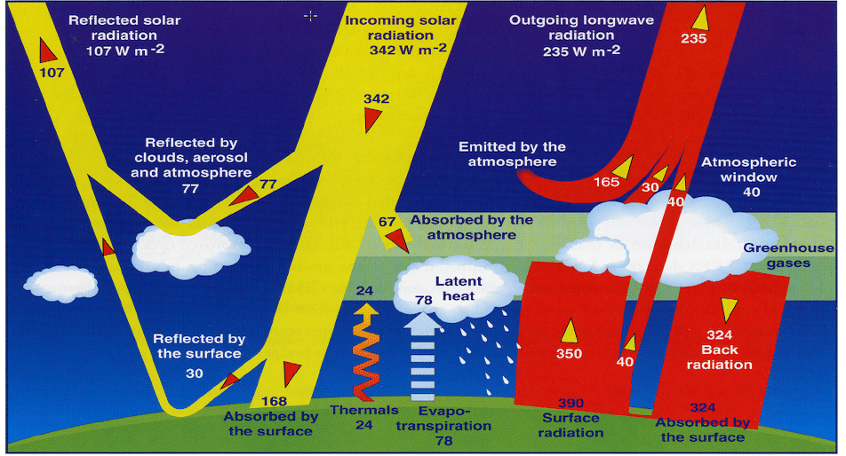
Physics GHG Basics

Slide 7
GHG Effect On Planet Earth
today’s life depends on presence of GHGs:
no GHGs: –18°C = 255°k = 0°f .
actual: +14°C = 287°k = 57°f .
what about venus?

Slide 8
Venus?
venus: 460°C; 98% co₂.
water is required for stone weathering of co₂.
Earth: 14°C; 0.0004% co₂.
fearing 0.0008% co₂.
humans are not that important! life on Earth will not end due to human co₂ emissions.
mars: –65°C; 96% co₂.
can reach +20°C in summer on the equator

Slide 9
Earth’s Past
what do boffins know about the past?

Slide 10
Deep Time Introduction
deep time: $≈$ 500 million years.
homo habilis: $≈$ 2 million years ago.
homo sapiens: $≈$ 0.3 million years.
where/what can we measure exactly?
satellites were not as good then.
limited by data types (e.g., spores), and
limited by data spots (e.g., latitude).
darn planet is uncooperative. it also changed temp slope gradient across latitudes and even entire continents, too! Animation of Continents

Slide 11
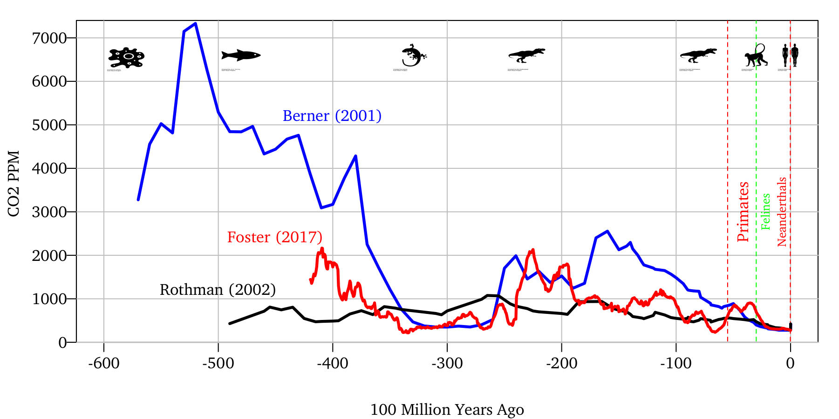
Deep Time Co₂ (Different Estimates)

Slide 12
Perspectives And Temperature?
co₂ is planetwide.
800 ppm was not unusual for 500 million years
800 ppm was very unusual for recent 50 million years
temperature is highly geography dependent.
much harder to measure.

Slide 13
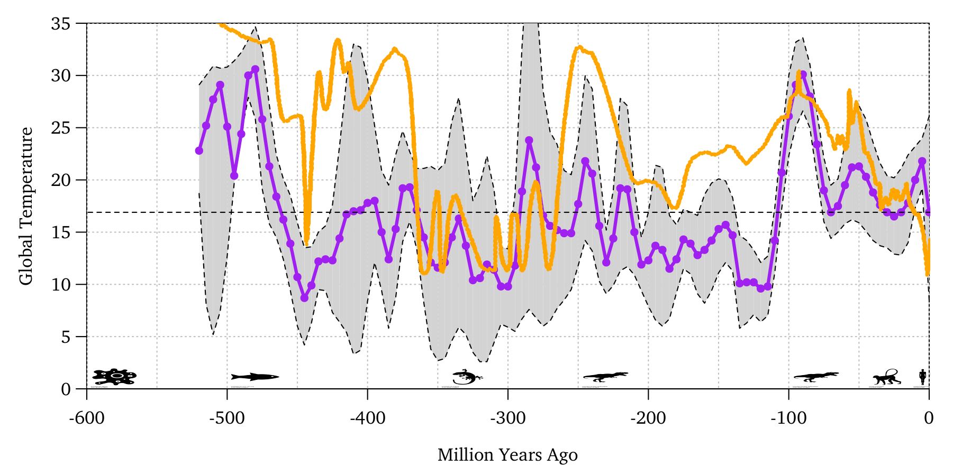
Deep Time Temperature (Different Estimates)

Slide 14
Earth has experienced very large temperature changes even before humans arrived on the scene.
temperatures of 3°C higher than today were common over 500 million years;
but Earth and its creatures looked very different!
(better get ready)

Slide 15
Ice Age Question
is Earth in an ice age?
what exactly is an ice age?

Slide 16
What Is An Ice Age?
ice age = polar ice year round
30% of last 2.5 billion years.
snowball Earth $<$ ice age $<$ greenhouse Earth
the cambrian explosion of life occurred after the last snowball Earth ended about 530 million years ago.
more fascinating background on Earth’s ages

Slide 17
Current Ice Age
current ice age
ongoing for 50 million years;
even primates (monkeys) have only known this ice age;
humans could plausibly see its end.
within ice age
glacial = getting colder; glaciers advancing.
interglacial = getting warmer; glaciers retreating.
it is not novel to see glaciers retreating! it’s the very definition of an interglacial period.

Slide 18
Deep-Time CO₂ ↔ Temp Association?
do you see a relationship between co₂ and temperatures over the last 400 million years?

Slide 19
I do not,
but this is irrelevant for today, anyway:
sun was different,
continents were different,
rocks were different,
life was different,
and our measurements are highly uncertain, too.
PS: these are exogenous inputs into the system.

Slide 20
Look Elsewhere For Evidence!
we need to look at shorter time intervals
where we have better authoritative data, too!
we need to look at more “human” times.
home sapiens sapiens exists for about 300,000 years.

Slide 21
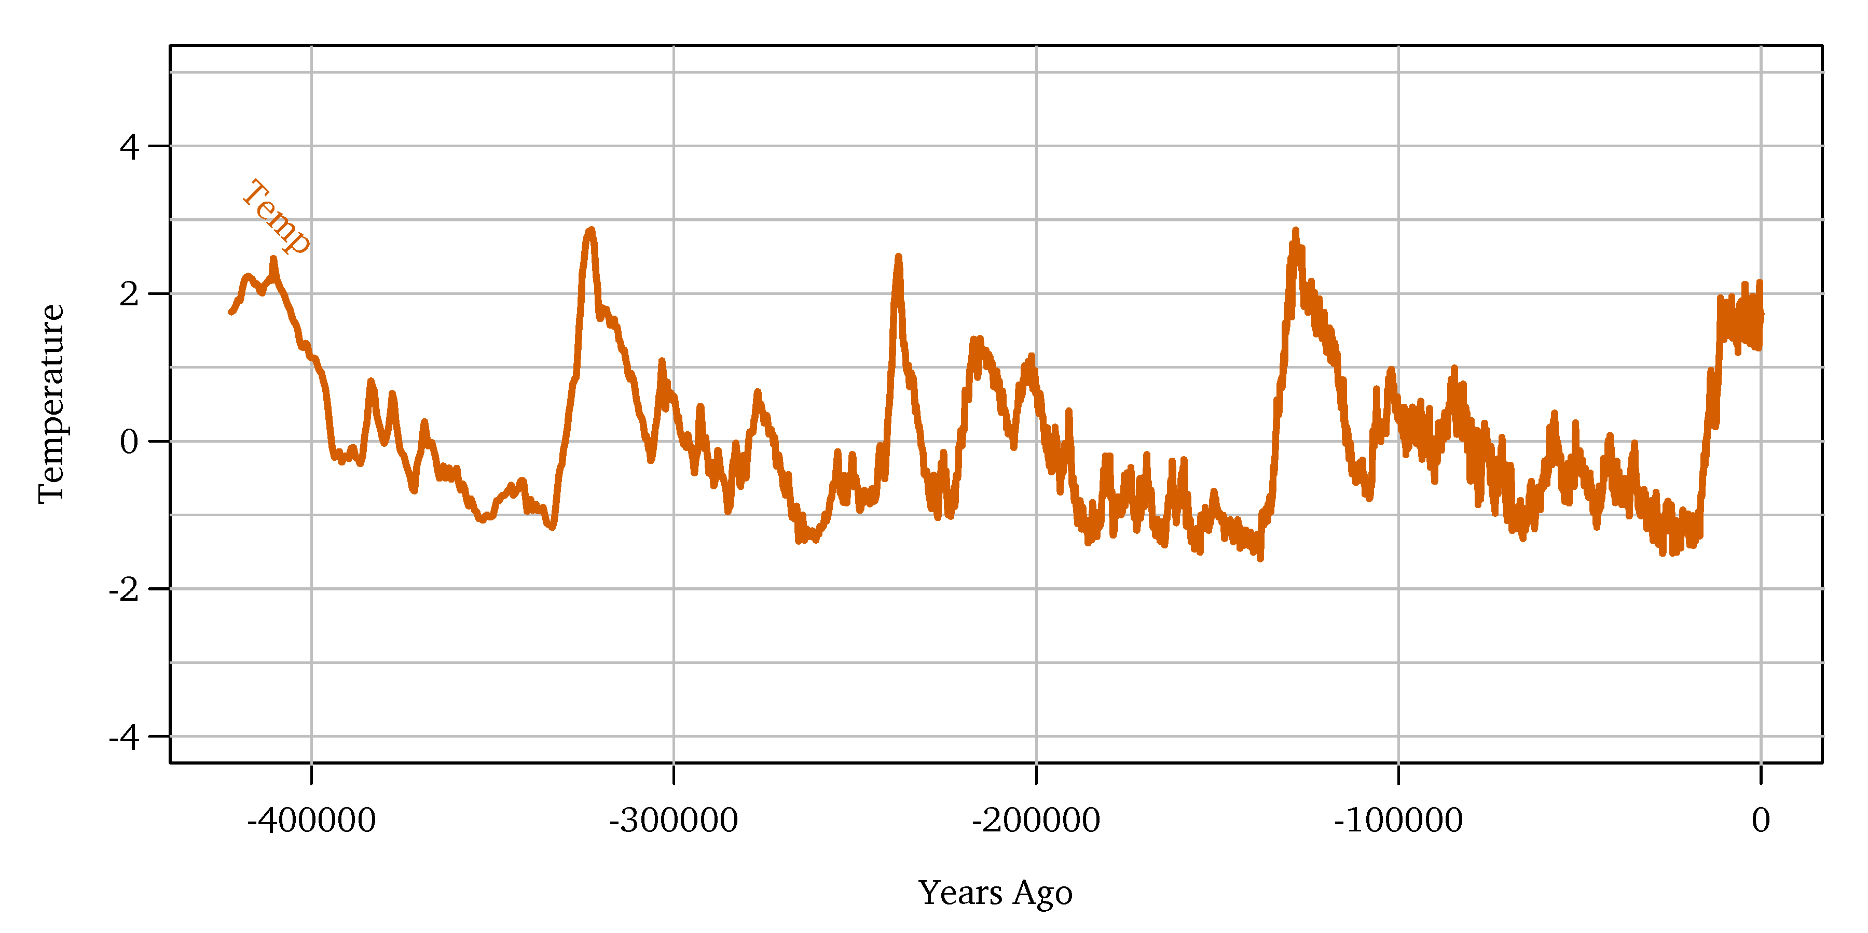
Homo Sapiens’ Temperature

Slide 22
You Are Here
in the last glacial maximum ($≈$ 15,000 years ago):
it was -6°C colder!
sea level was about 150-200 feet (60 meters) lower.
nyc was under about 100 meters ice.
we were near a glacial minimum = interglacial maximum.

Slide 23
Current Interglacial Maximum
civilization has developed in this very warm 10,000-year interglacial period since the last glacial maximum.
it also seems unusually stable.
we are the top of the curve already.
… but also still going higher!
don’t count on remaining lucky in the future:
Earth temp will change again, up and down,
right now warmest in hundred-thousands and perhaps millions of years.

Slide 24
What Is The World’s Optimal Temperature?
are we at it?
is it where we were in 1980?
is it even lower than 1980s?
is it “whatever it is at the moment”?

Slide 25
Homo CO₂ ↔ Temp Association
sometimes a graph speaks louder than a thousand words!
smoking gun for co₂ → temp !?

Slide 26
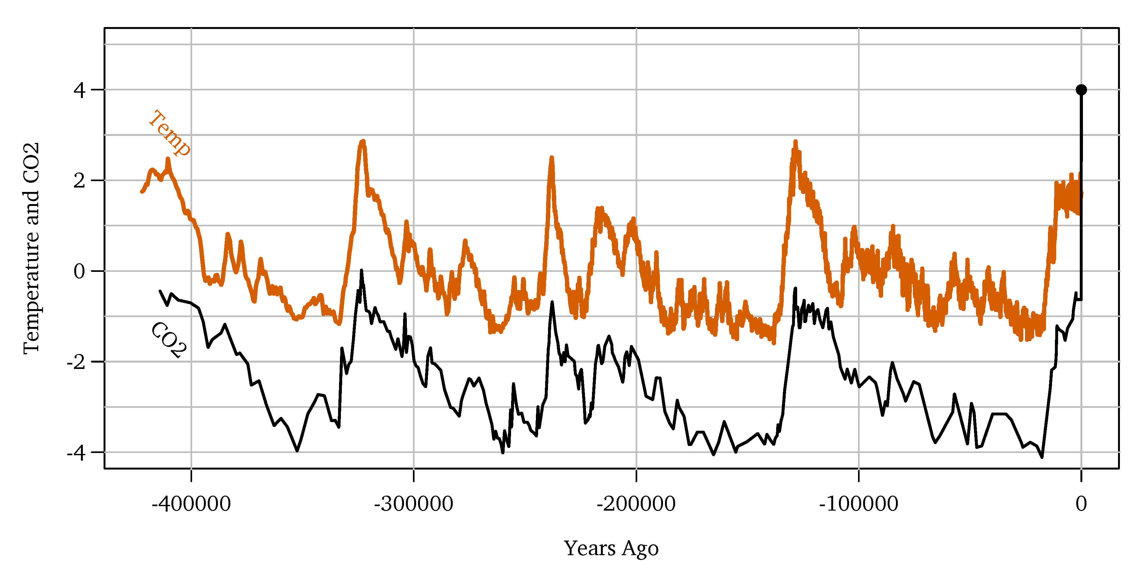

Slide 27
Smoking Gun?
no! this graph is often shown to deceive!
many other factors could have caused this graph’s association:
some factors influenced not only co₂ but also temperature.
boffins do not even know all factors.
temperature even influences plant/co₂ (cycle)!
and feedback is not mutually exclusive.
time precedence?: (temp → co₂) $≫$ (co₂ → temp).

Slide 28
CO₂ ↔ Temperature Association Evidence
I would ignore above evidence as mostly irrelevant.
requires strong models that may or may not be true.
I prefer to focus on more recent evidence,
for very good scientific reasons.
let me show you

Slide 29
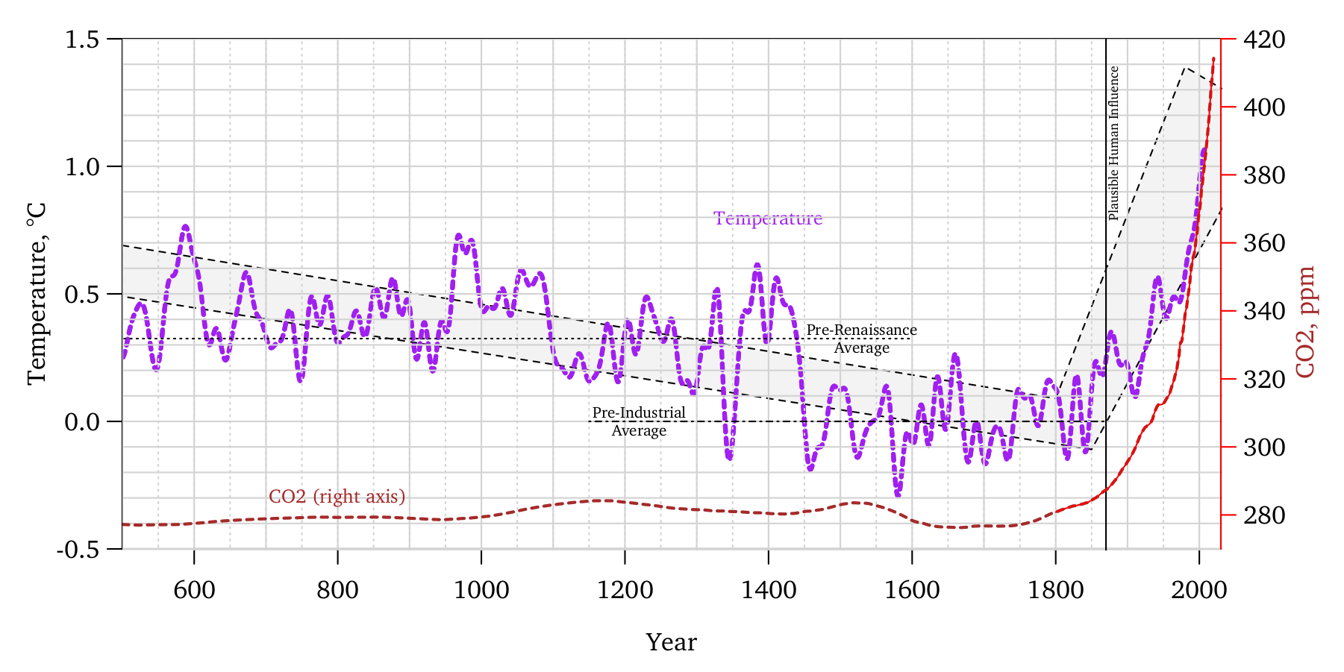
Millenium Hockeystick

Slide 30
Great Evidence (I)
global warming since about 1800 is indisputable!
since 1000s, still many organic records;
since 1880s, many global weather stations 24/7;
since 1980s, satellites measuring entire Earth 24/7.
ps: there was a coordinated fossil-fuel campaign to smear mann et al.

Slide 31
Great Evidence (II)
this evidence is far more relevant:
in earlier figures, co₂ was endogenous.
see above for more exogenous aspects, too.
but non-linear internal dynamics are quasi exog at t.
here we know what caused this co₂ spike!
it was us humans!
this ‘identification’ is a very big deal!

Slide 32
Aligned CO₂ ↔ Temp Millenium
this evidence is as near-perfect as non-experimental science usually gets
far less likely to be coincidental.
boffins have good co₂-based explanations.
alternatives are far more speculative.

Slide 33
But Is It 100% Certain?
no. it’s near-perfect, but not perfect.
we would want to run an experiment where we stop and resume co₂ emissions a few times to see if anything else seems to matter, too, ideally starting from the same conditions.
boffins are only humans, too.
what if either/they are wrong? a lot is at stake.

Slide 34
Bias in Hypothesis Testing
a sequence of numbers has an order to it. for example, 1-2-3 is a different sequence from 3-2-1. some sequences of 3 numbers work, others do not. your goal is to figure out my rule—but you can’t simply ask me for it. instead you can conduct experiments on me. you can make up a 3 number sequence and i’ll tell you if fits. then you can make up another sequence, i’ll tell you again, and we’ll keep going until you’re mostly (95%) confident you know the rule inside my head. let’s do the first sequence together: 2-4-6 is good.
you pay $1 for each guess. you get $5 if you state the correct rule. you lose $5 if you state the wrong rule.
run online, then tell me how much I owe you.

Slide 35
Majority-Minority Agreement
boffins are in near-perfect agreement:
Earth is warming rapidly.
co₂ is the main GHG priming temperature.
water vapor is the strongest GHG:
perhaps 97%;
perhaps 65-85%.
co₂ → temp.
co₂ → temp → water vapor → temp.

Slide 36
Majority-Minority DisAgreement
question: are GHGs 100% or just, say, 80%?
in GHG → temp → water vapor → temp .
or also (in addition?):
x → temp → water vapor → temp ?
x → water vapor → temp ?
even if GHGs are capable of explaining warming, this is not proof that they committed the deed. where is the burden of proof? is reasonable doubt enough? boffins do not have exclusionary dna evidence here.

Slide 37
Should We Allow Disagreement??
policy relevant! → controversial.
science requires aggressive disagreement.
but some is beyond the pale now:
everyone distrusts other motives now.
climate boffins suspect (paid) trolls.
rightly so! there are many.
does the end justify the means?
boffins are only (concerned) humans, too.
should “we” highlight unexplained phenomena?

Slide 38
Ideal Way To Resolve Disagreement
we want 1,000 years of cloud data and reruns
and many other variables,
so boffins can try out alternative explanations for shocks to water vapor, that might not have been driven by co₂.
they simply don’t have this data.
in the land of the blind, the one-eyed man is king.

Slide 39
What Is Best Now?
today’s debate is often about whether humanity should
spend a lot of money now?
(before the boffins are 100% sure)
or wait until boffins are certain?
(and perhaps milllions more of us will die?)
(cornell-welch posit that it’s actually an irrelevant debate.)

Slide 40
Further Measurement Problems
climate has natural variation.
weather is chaotic in time and space.
renaissance was warmer
ps: little ice age was not an ice age, and may have only been in northern hemisphere.
all primates only existed in an ice age,
but perhaps your grandchildren won’t be.

Slide 41
Minor Clarification: Baseline Year
start from renaissance or pre-industrial?
bottom of hockey stick is around 1800
1500 was about 0.3-0.5°C warmer
1°C vs 1.3°C warming?.
→ 0.3°C difference in quoted warming.
usually quoted from pre-industrial.
makes increase-to-date look bigger,
makes percent-relative-to-future look smaller.
no right or wrong here baseline,
but it makes for many easy number confusions.

Slide 42
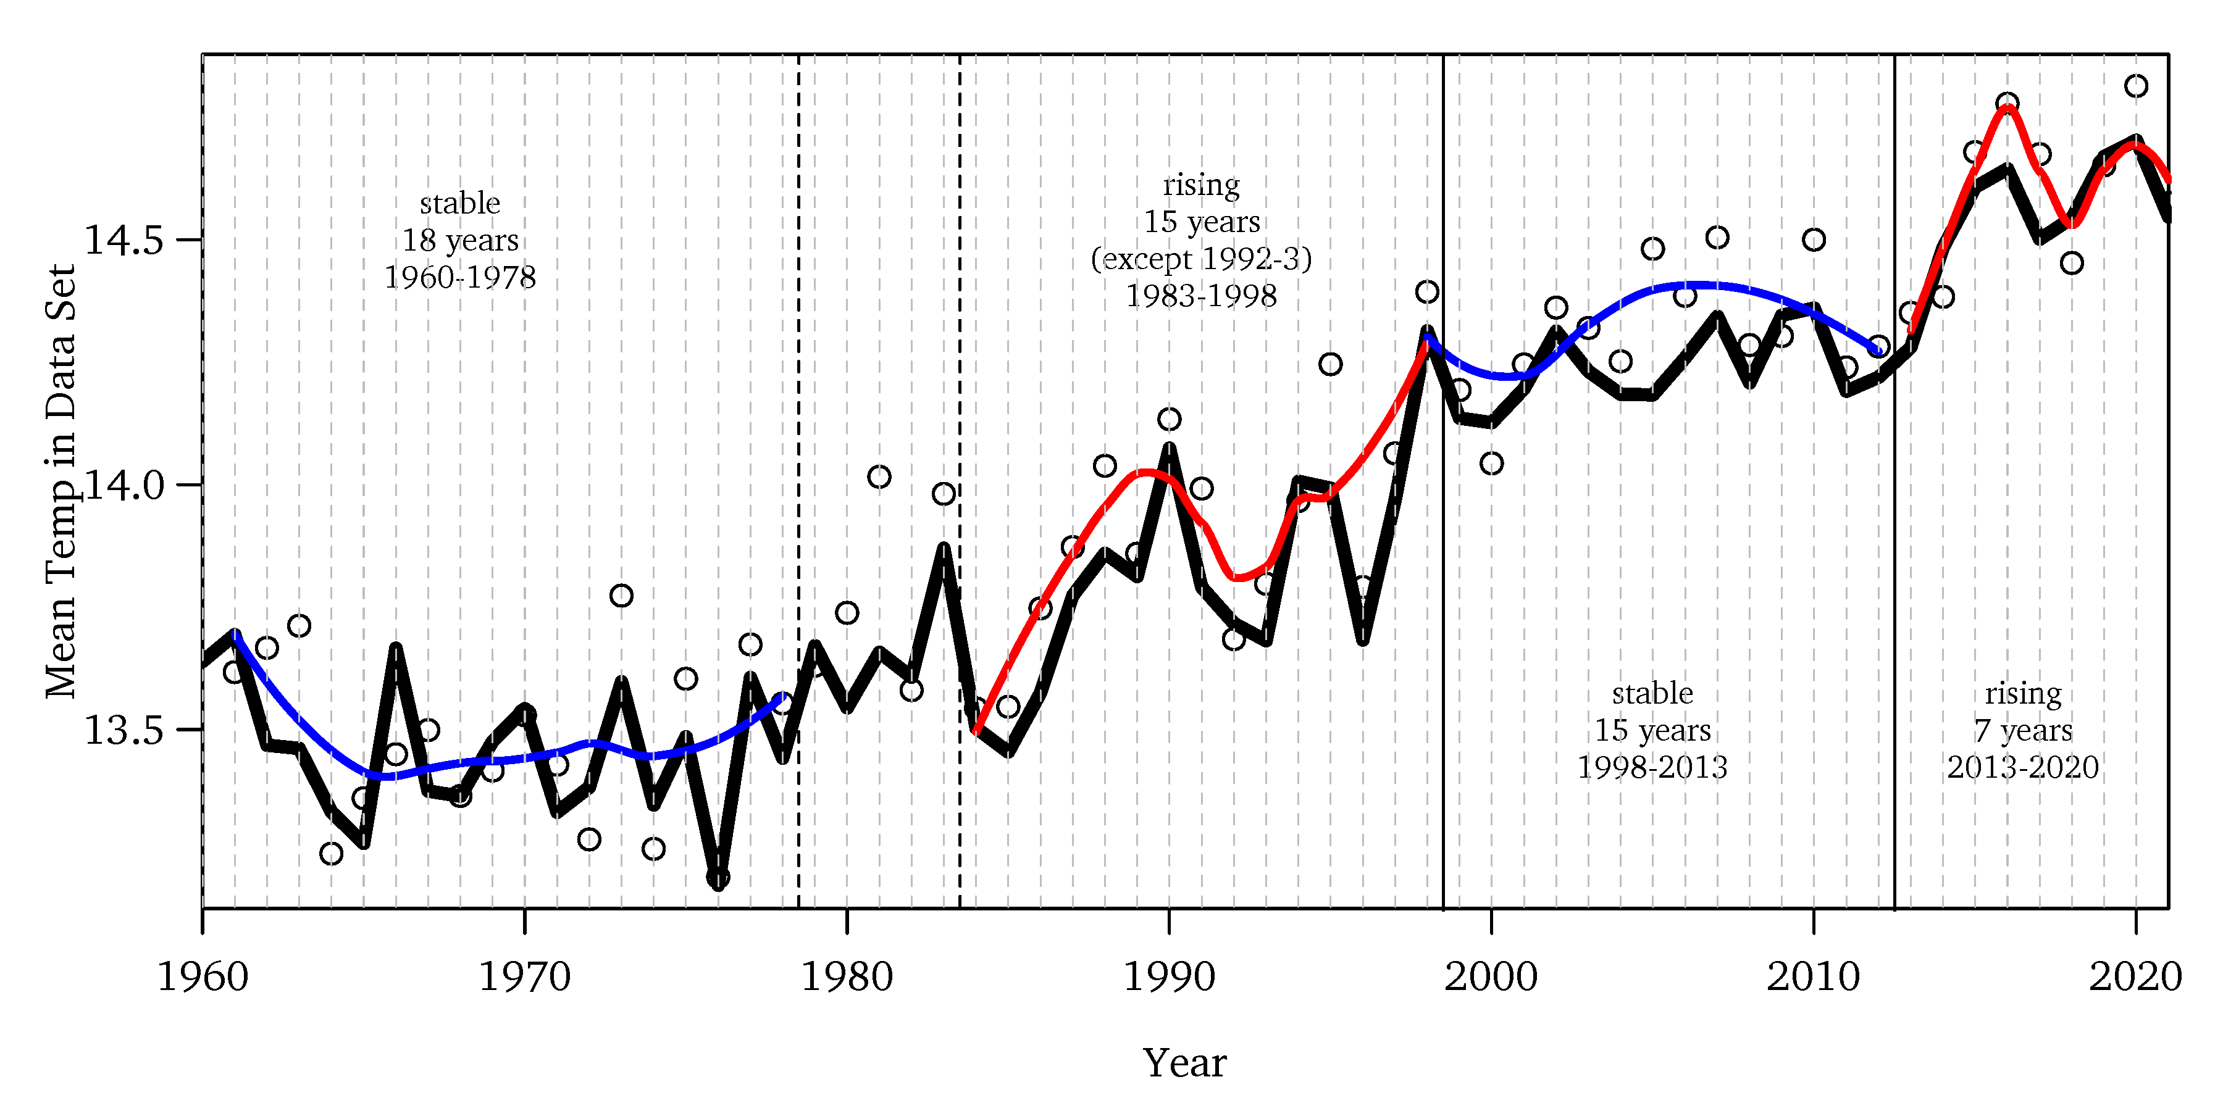

Slide 43
Some Remaining Little Puzzles
post-2010 temp spike?
seems too soon for co₂ smooth increase.
or past seems too little?
possible cause: cleaner coal? so₂ peaked 1980.
post-2000 hiatus?
el nino buffer responsible for 2000-2010?

Slide 44
humanity before 1930 could not have done much, but warming began in 1800?!
some due to volcanoes, but not all.
scientists often find (ex-post) reasons for deviations
e.g., phaseout of sulfur-laden coal
“cherry-picking” is possible because of “noise”
but what is “noise”?
there was ultimately some cause behind the hiatus, too

Slide 45
and
what really caused 500,000 years of variations?
why has it warmed more at night?
why has it warmed more at higher latitudes?
interesting questions are not disputing main insight: global warming is continuing

Slide 46
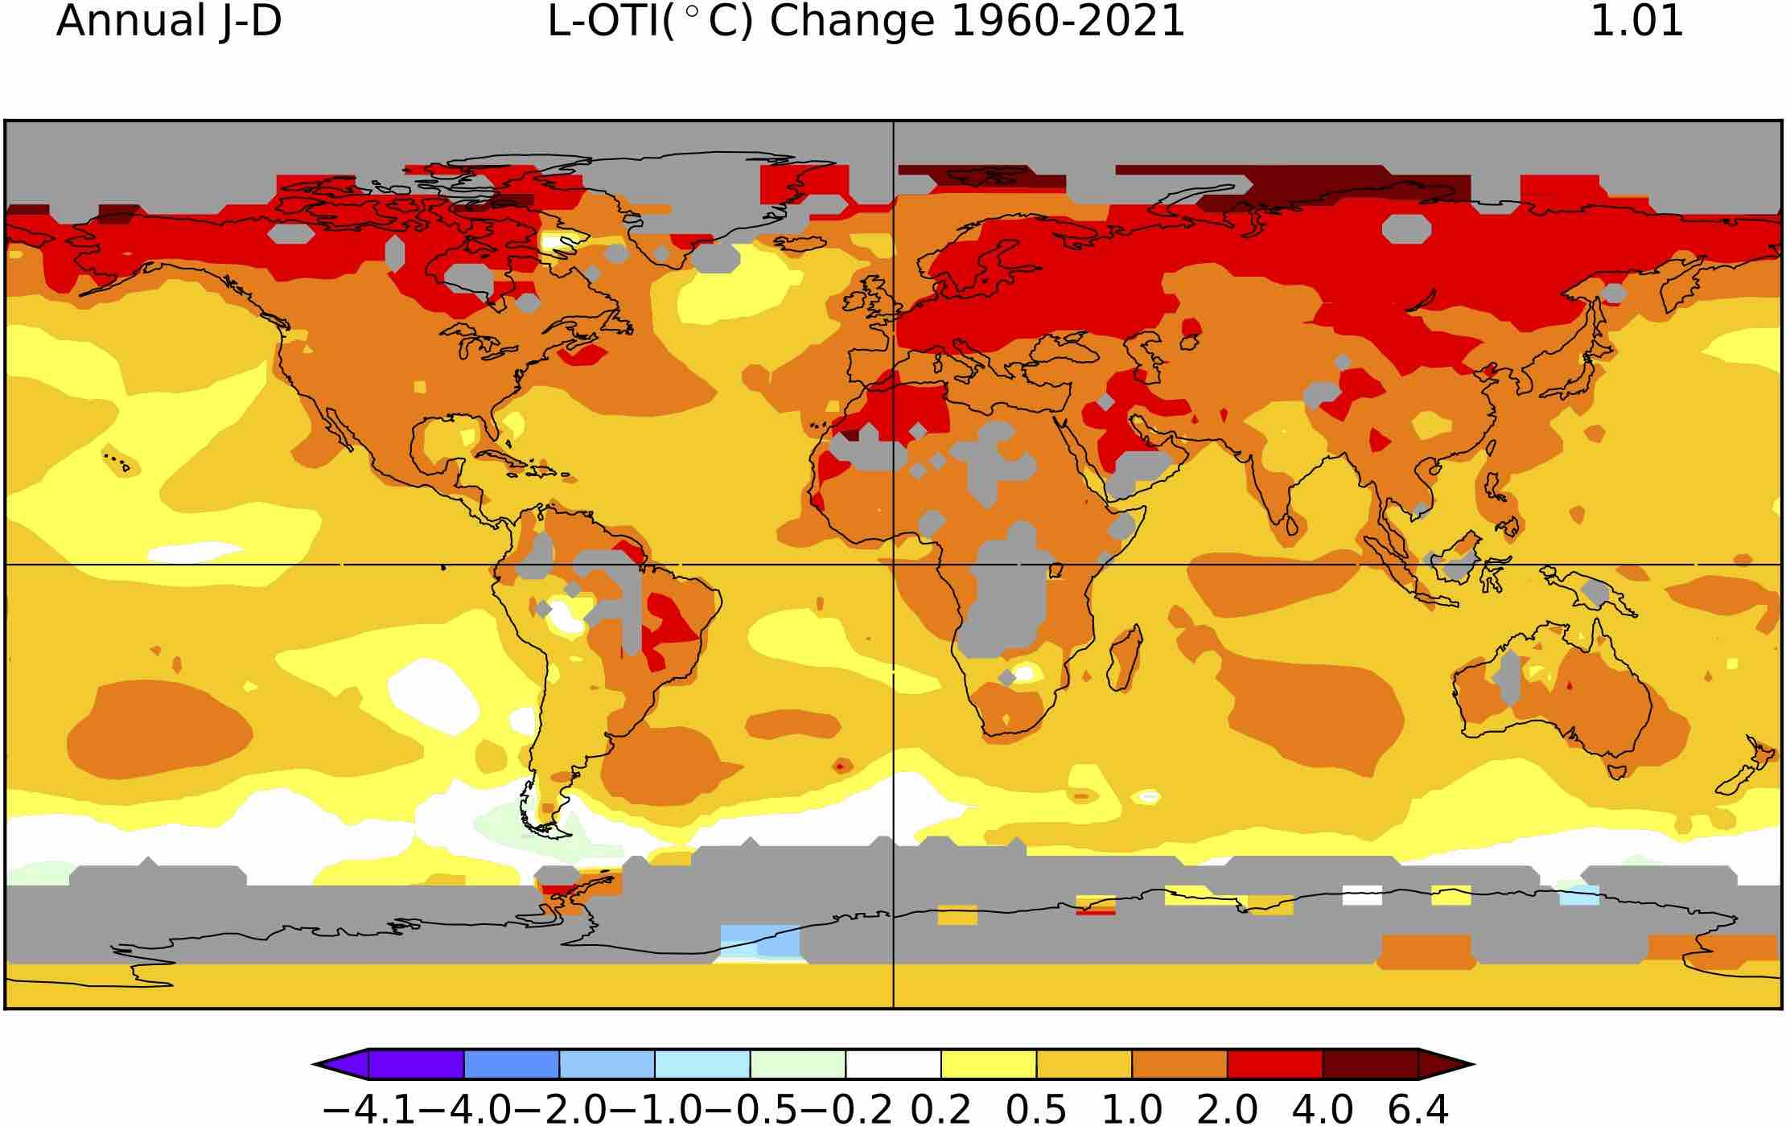

Slide 47
Just Hold On
we will learn more “soon”:
soon = think 50 years.
current temperature change is lightning fast by geological standards.

Slide 48
More Climate Science Slander
were past climate models wrong?
not really!
urban myth.

Slide 49
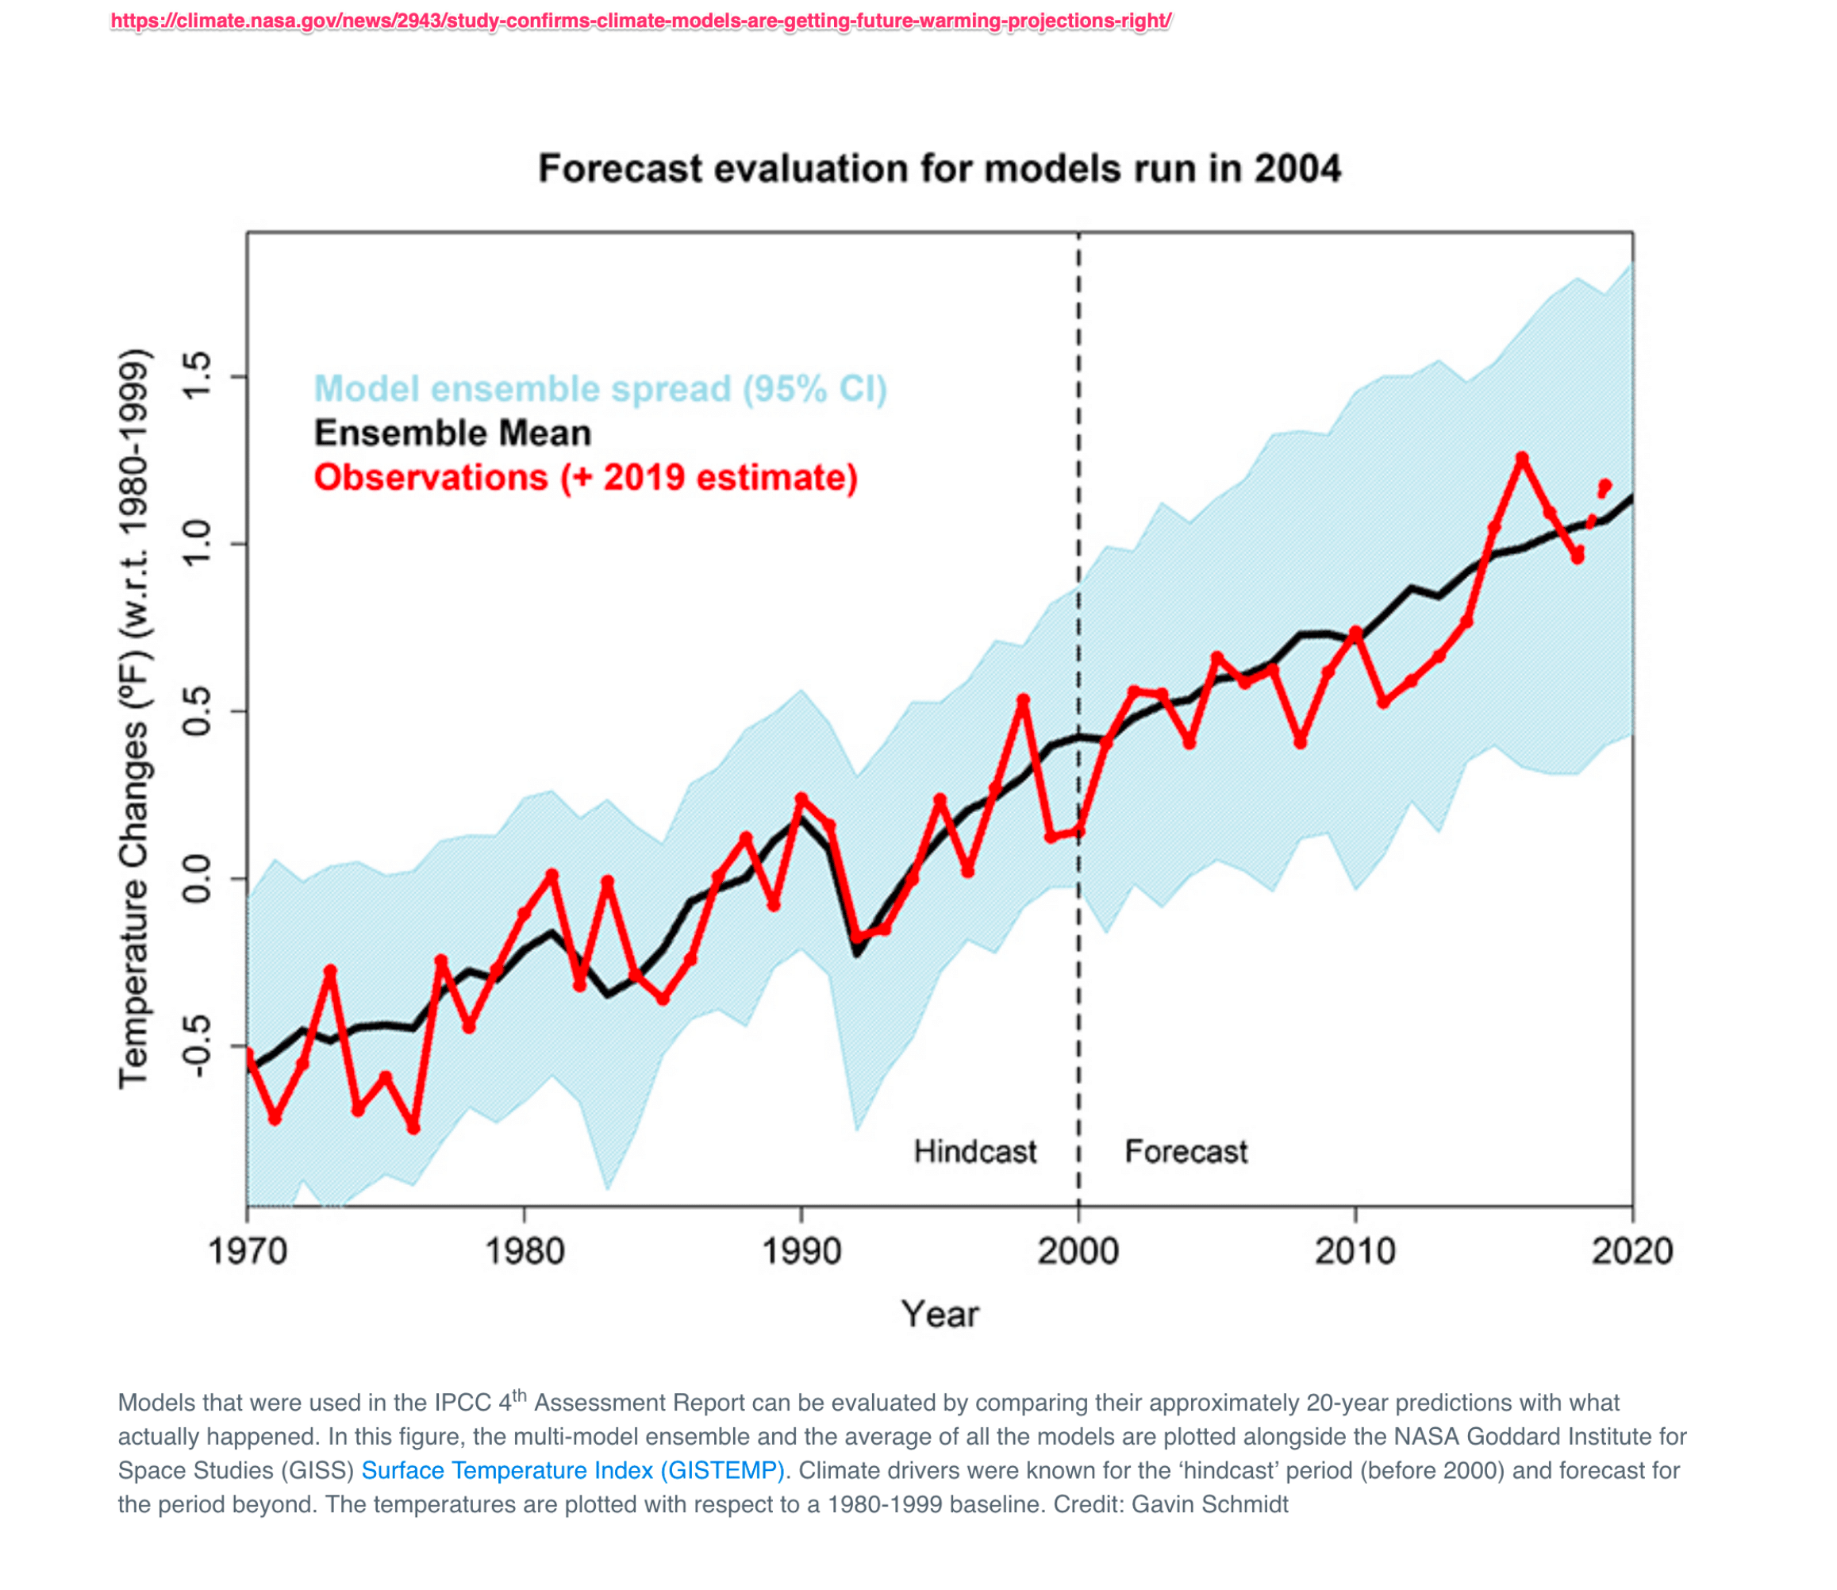

Slide 50
Summary Of Undeniable Facts
Earth has been warming (about 1°C since 1980).
Earth will be warming a lot more (maybe another 2°C).
satellites can measure incoming and outgoing radiation (like a kettle on a stove).
Earth is not in thermal equilibrium.
only half of caused-by-already-emitted warming has occurred by now — maybe 0.7°C out of 1.4°C .
warming will be coming — unless something else (asteroid? super-volcano? nuclear war?) throws it off equilibrium.

Slide 51
climate disasters will likely be more common:
slowly increasing.
yet, specific events are and will always be difficult to attribute.
if you strongly believe in fitted simulation models, then you can do some attribution relative to null hypothesis.
if you want the data to speak for themselves, then individual events are not attributable due to large system variances.
more energy injected into system Earth will eventually have an effect on average.
(this does not necessarily mean more damage)

Slide 52
Click-Bait
attention is also increasing:
more people,
more media,
with a good alarming narrative for an interested clientele
more impact and more notice.

Slide 53
Unarguable Conclusions
Earth has been warming for 200 years.
warming has recently been accelerating.
anthropogenic GHGs (co₂) are major contributors:
basic physics demands it.
long-lived GHGs prime a water vapor amplifier, although the role of clouds is not fully understood.
deniers are ignorant or disingenuous.

Slide 54
Arguable Conclusions
a minority wonders
could something other than human GHGs also play a role?
could human GHGs be only one part of the puzzle?
would be important if continuing (like GHG emissions)

